Slide 1

Targa Resources (TRGP)
ECI Utilities
24/02/2025
This presentation is for informational purposes only and is not an offer to buy or sell or a solicitation to buy or sell any securities, investment products or other financial product or service, or an official confirmation of any transaction.

Slide 2
1
4
Table of Contents
Company Overview
Valuation
1. Company Overview
9. Historical Share Price Performance
2. Business Model
10. Valuation Overview Incl. Football Field
3. Operating Forecast
11. Valuation Analysis
4. Shareholder Ownership
12. Comparables Overview
2
5
Industry Overview
Catalysts and Risks
5. Competitive Environment
13. Risk Considerations
6. Key Industry Trends
14. The Four W’s
7. Corporate Finance Activity
3
6
Investment Thesis
Recommendation
8. Rationale
15. Optimal Price Analysis
Add or remove slides if necessary

Slide 3
Agenda
Logo here
1
Company Overview
2
Industry Overview
3
Investment Thesis
4
Valuation
5
Catalysts and Risks
6
Recommendation

Slide 4
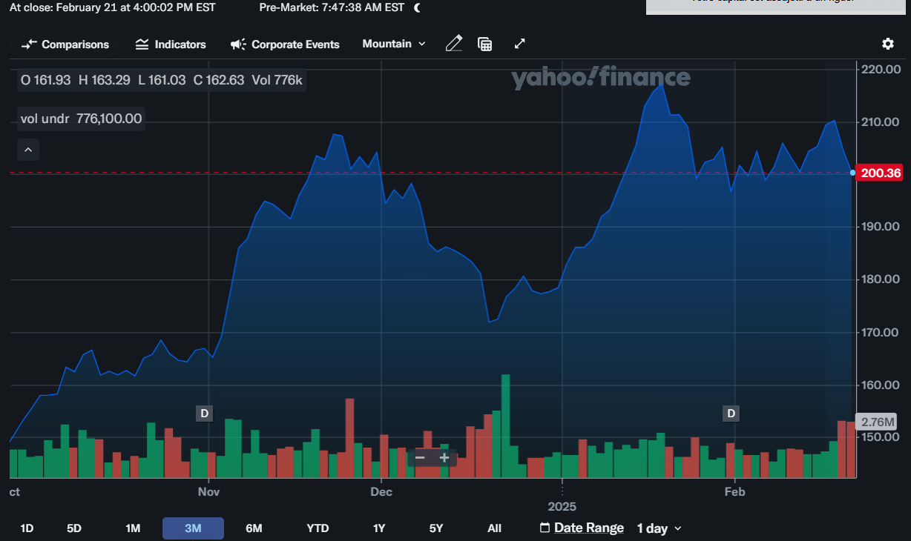
Company Overview
Company Highlights
Valuation & Share Performance
History: Founded in 2003, Targa expanded through key acquisitions, including Dynegy’s midstream assets ($2.35B, 2005) and Atlas Pipeline Partners ($7.7B, 2015). It went public in 2010.
Valuation: Stock performance is driven by energy prices, production volumes, and infrastructure expansion. As of 2025, shares trade at $198.47.
Strategy: Focus on operational excellence, sustainability, and NGL infrastructure growth, particularly in the Permian Basin.
Corporate Finance Transactions: Major deals include the 2015 Atlas acquisition and the Grand Prix NGL Pipeline project, enhancing transportation from the Permian Basin.
Ownership: Major institutional holders include Vanguard Group Inc. (12.45%), BlackRock Inc. (9.49%), State Street Corporation (6.37%), Wellington Management Group (5.88%), Geode Capital Management (2.72%), and Blackstone Inc. (2.15%) as of December 31, 2024.
Key Valuation Statistics
Enterprise Value | $57.81 B | Revenue (FY23) | $16.38B
Market Cap | $43.70 B | EBITDA (FY23) | $4.13B
P/E | 34.91 | EBITDA Margin ‘23 | 25.22%
EV/EBITDA | 14 | Debt / EV | 0.24
Cash | $157.3 M | Total Debt | $14.29 B
Industry Data | Average
Overall
EV/EBITDA - 14 | 11
EV/Revenue - 3.53 | 2.392
P/E - 34.91 | 25.6
Key Metrics | Unit
Gross Margin | $16.39Bn
ROIC | 20.7%
Debt to Equity | 323.44%
Cash | $157.3 Mn
ROA | 7.76%
Pretax Margin | $1.93 Bn
Share Price | Current: $200.36 | High/Low: $161.24/ $217.34
Revenue Mix | % | Gross ($bn)
Gathering and Processing | 32.67% | $7.23
Logistics and Transportation | 67.33% | $13.66
Overlapping Revenue Adjusted in Consolidated Statements
Source: Targa Resources Website
Source: Yahoo Finance

Slide 5
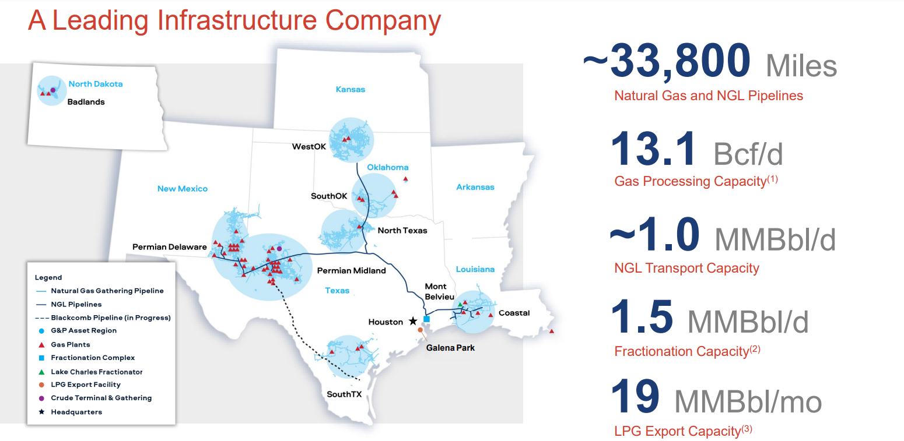





Targa Business Model
Operating Segments
Key Figures as of Feb 2025
1. Gathering and Processing Segment
Core Activities: Gathering/purchasing/sale of natural gas, removing impurities, processing raw natural gas, extracting NGLs & gathering/terminaling/purchase/sale of crude oil.
2. Logistics and Transportation Segment (Downstream Business)
Core Activities: Converting mixed NGLs into NGL products, transporting, storing, fractionating, terminaling, and marketing NGLs and NGL products. Additional Services: Services to LPG exporters and natural gas supply/marketing activities supporting other business segments.
3. Other Segment
Contains unrealized mark-to-market gains/losses from derivative contracts not designated as cash flow hedges
Competitors
Source: Targa Investor Presentation

Slide 6
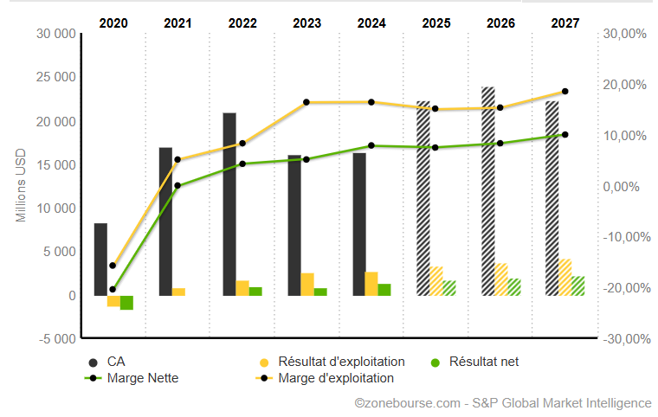
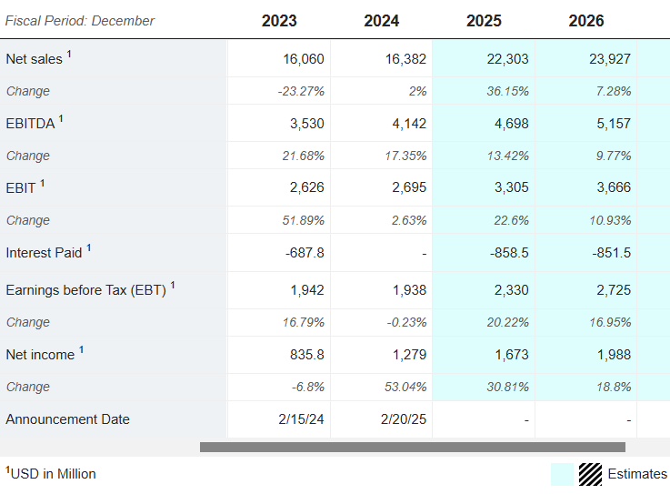
Operating Forecast
Revenue, EBITDA Forecast & Key Drivers
Sources: Marketscreener
Key Drivers
Strong Q4 Performance: Targa reported a Q4 2024 net income of $351 million, up from $299.6 million in Q4 2023.
EBITDA Growth: Adjusted EBITDA for Q4 2024 reached $1.12 billion, reflecting solid financial performance.
2025 Projections: Full-year 2025 adjusted EBITDA is expected to range between $4.65B - $4.85B, a 15% increase over 2024.
Dividend Increase: Targa plans a 33% dividend hike, raising it to $4.00 per share in 2025.
Rising Global Demand: Natural gas & NGL demand is projected to grow, particularly in Asian markets (IEA).
Limited Supply Growth: Supply expansion remains modest, leading to tighter market conditions and stronger pricing.
U.S. Price Forecast: The Henry Hub spot price is now expected to average $3.80/MMBtu in 2025 due to increased consumption (EIA).

Slide 7
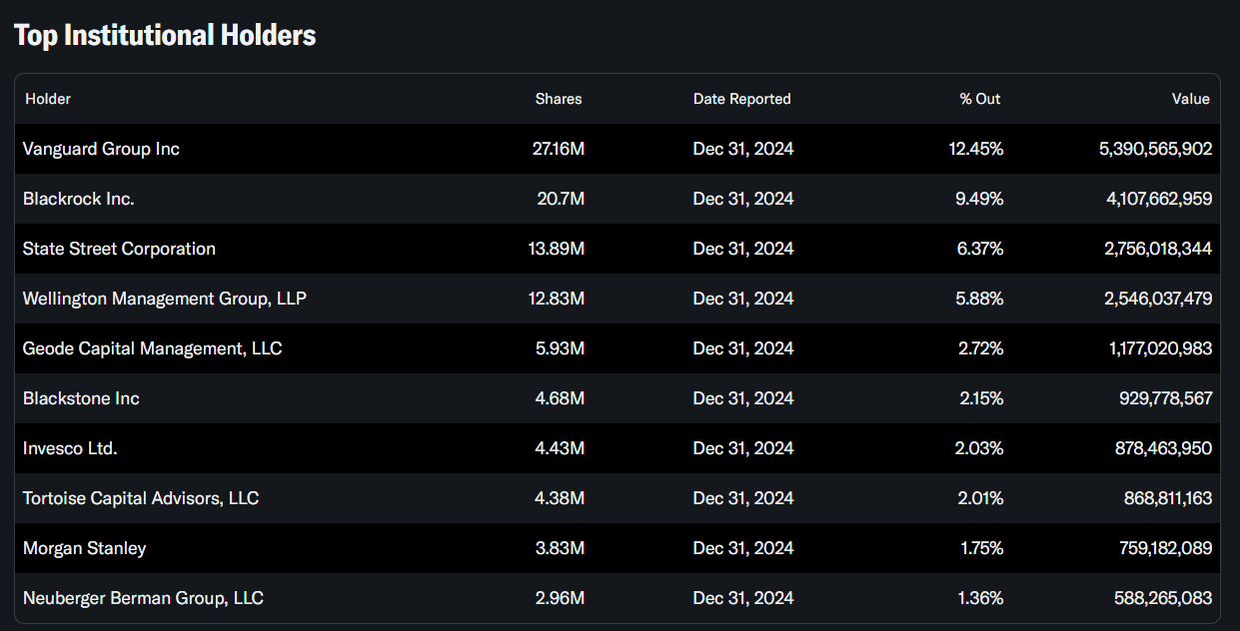
Shareholder Ownership Analysis
Ownership Analysis
Targa Resources' shareholder ownership is primarily dominated by institutional investors, with Vanguard holding 12.45%, BlackRock owning 9.49%, and Wellington Trust possessing 5.88%, while insiders own 22.01%, retail investors hold a minimal share, and the majority of shareholders (76.15%) are based in the U.S. with smaller portions in the U.K., Canada, and France.
Sources: Yahoo Finance

Slide 8
Agenda
Logo here
1
Company Overview
2
Industry Overview
3
Investment Thesis
4
Valuation
5
Catalysts and Risks
6
Recommendation

Slide 9
Investment Thesis
Our View
The Implications
Expansion in Midstream Infrastructure
Significant investments in natural gas and natural gas liquids infrastructure expansion, including new fractionation and pipeline projects.
Copper and Lithium Ventures
Expansion of Grand Prix NGL Pipeline and additional fractionation capacity at Mont Belvieu.
Positions Targa to capitalize on growing U.S domestic demand after tariffs applied to Canadian gas.
Increased processing and transport capabilities enhance revenue stability and scalability.
Commitment to Energy Transition & Efficiency
Focus on reducing emissions through carbon capture initiatives and efficiency improvements in natural gas processing.
Increasing investment in renewable natural gas and sustainable midstream solutions.
Stronger positioning as ESG factors increasingly influence investment decisions and regulatory policies.
Potential for long-term cost savings and premium pricing in eco-conscious markets.
Strong free cash flow supporting dividend growth and share repurchases.
Diversified revenue streams across natural gas gathering, processing, and NGL transportation.
Targa remains resilient in both high and low commodity price environments.
Reduced reliance on commodity price fluctuations, ensuring consistent performance and adaptability.
Resilient Financials & Diversified Business Model

Slide 10
Agenda
Logo here
1
Company Overview
2
Industry overview
3
Investment Thesis
4
Valuation
5
Catalysts and Risks
6
Recommendation

Slide 11
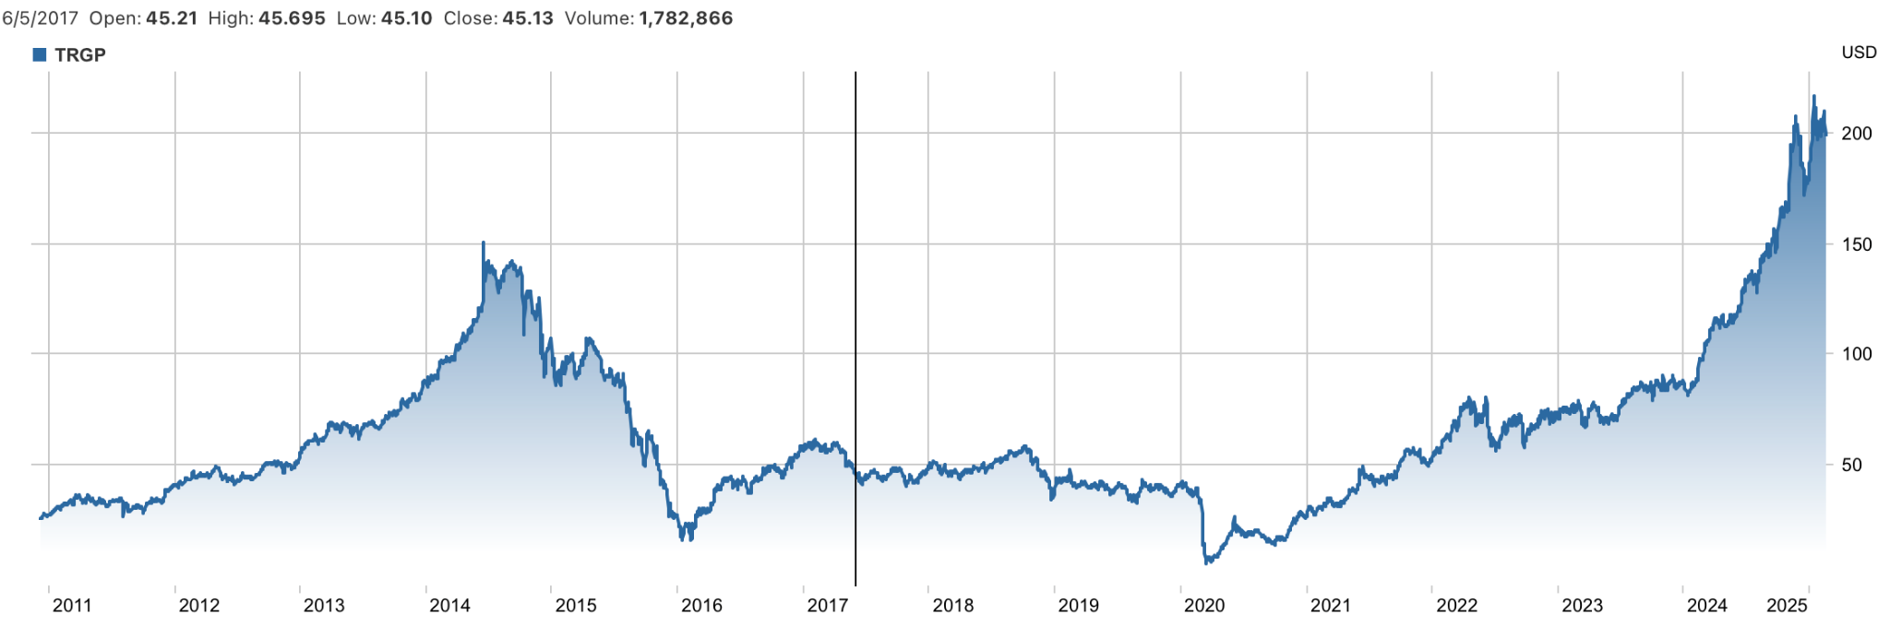
Historical Share Price Analysis
Key Events & Share Price Drivers
6
2
n
5
1
3
4
Dec 7, 2010 – Targa Resources (TRGP) IPO at $22/share, listing 16.375M shares on NYSE.
2) Sep, 2014 – TRGP stock fell as NGL prices dropped and its $7.7B Atlas acquisition raised debt concerns.
3) Mar, 2016 – TRGP’s stock rebounded after securing $1 billion from investors, enhancing liquidity and reducing debt.
4) Feb, 2020 – TRGP fell amid COVID-19 and the oil price war.
5) Jan 2024 – TRGP surged on strong Q4 2023 earnings, a 50% dividend hike, and a $40.6M share repurchase.
6) Jan 21, 2025 – TRGP reached an all-time high closing price of $217.22.

Slide 12
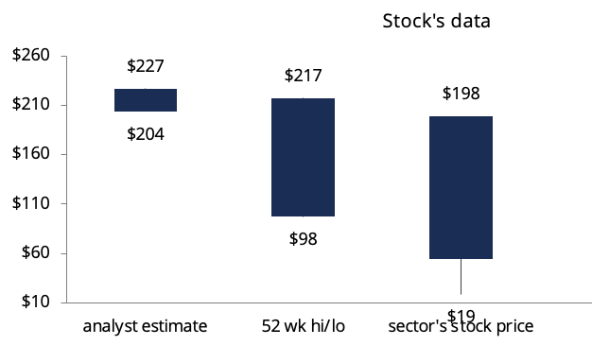
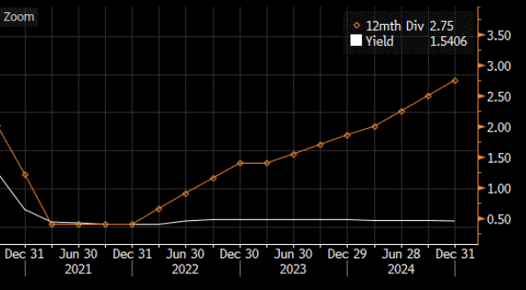
Valuation Summary
Stock Price Performance
Valuation Football Field
TRGP trades at $198.47, up 103.7% YoY, beating the S&P 500’s 18.31% gain
YoY, It outperforms peers:
KMI: +63.28%
WMB: +73.51%
Record Adjusted EBITDA Growth – TRGP’s adjusted EBITDA rose by 17% YoY, driven by higher Permian volumes and increased NGL prices
Strategic investments: Targa’s expansion in the Permian Basin, including the addition of new processing plants, has positioned the company to capitalize on increased production levels
Broker Estimates | Target Prices ($) | Upside (%) | Rating
Wells Fargo (21/02/2025) | $227 | +14.4% | Buy
Mizuho (20/02/2025) | $226 | +14.1% | Buy
CIti group (25/02/2025) | $227 | +14.4% | Buy
Goldman Sachs (24/02/2025) | $222 | +11.9% | Buy

Slide 13
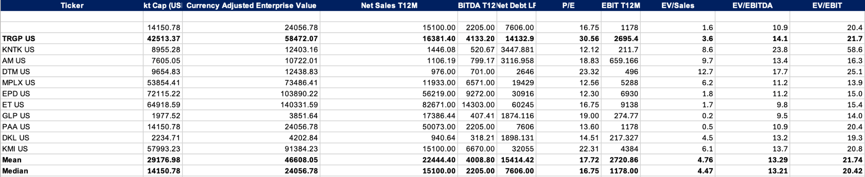
Comparables Analysis
Comparable Company Rationale
The midstream energy sector plays a key role in transporting and processing oil and gas, benefiting from stable cash flows and strong margins. Larger players dominate with diversified operations, while smaller firms focus on niche markets. Investor confidence varies, with some companies trading at higher valuations due to growth prospects.
.
(in millions of U.S. dollars)
Stock
Equity
Firm
Net Income
TEV / EBITDA
Price / Earnings
Company
Symbol
Price
Value
Value
LTM
FY+1
LTM
FY+1
LTM
FY+1
EXAMPLE
VALE
NYSE:GE
161.82
$57,850
$47,780
2,410
2,800
2.8x
2.6x
19.8x
17.1x
BHP
NYSE:LHX
214.05
$159,410
$145,410
13,700
14,200
5.5x
5.2x
10.6x
10.2x
AngloAmerican
NYSE:GD
287.09
$53,550
$30,000
3,100
3,500
3.7x
3.4x
9.7x
8.6x
Glencore
NYSE:LMT
464.93
$49,700
$68,340
4,600
5,100
5.3x
4.9x
12.4x
11.4x
Chalco
NYSE:TDG
1,248.03
$20,500
$14,826
1,200
1,300
5.9x
5.4x
14.9x
13.4x
RIO Tinto
NYSE:BA
$167.84
$103,034
$143,438
2.6x
1.9x
1.8x
2.6x
10.5x
46.50x
23.10x
29.20x
NM
High
$134,353
$180,526
10.7x
12.5x
10.9x
11.3x
36.2x
25.4x
24.4x
21.7x
46.6x
42.9x
37.9x
39.5x
Median
$54,999
$70,212
2.4x
2.3x
1.9x
2.2x
13.5x
18.1x
16.35x
15.0x
101.5x
21.1x
18.7x
19.6x
Mean
$62,219
$71,420
2.8x
2.9x
2.9x
3.2x
16.7x
20.2x
17.4x
17.4x
103.8x
22.9x
22.4x
23.1x
Low
$16.165
$18,685
1.4x
1.4x
1.2x
1.29x
12.1x
10.6x
11.40x
13.0x
12.9x
17.3x
12.8x
13.5x

Slide 14
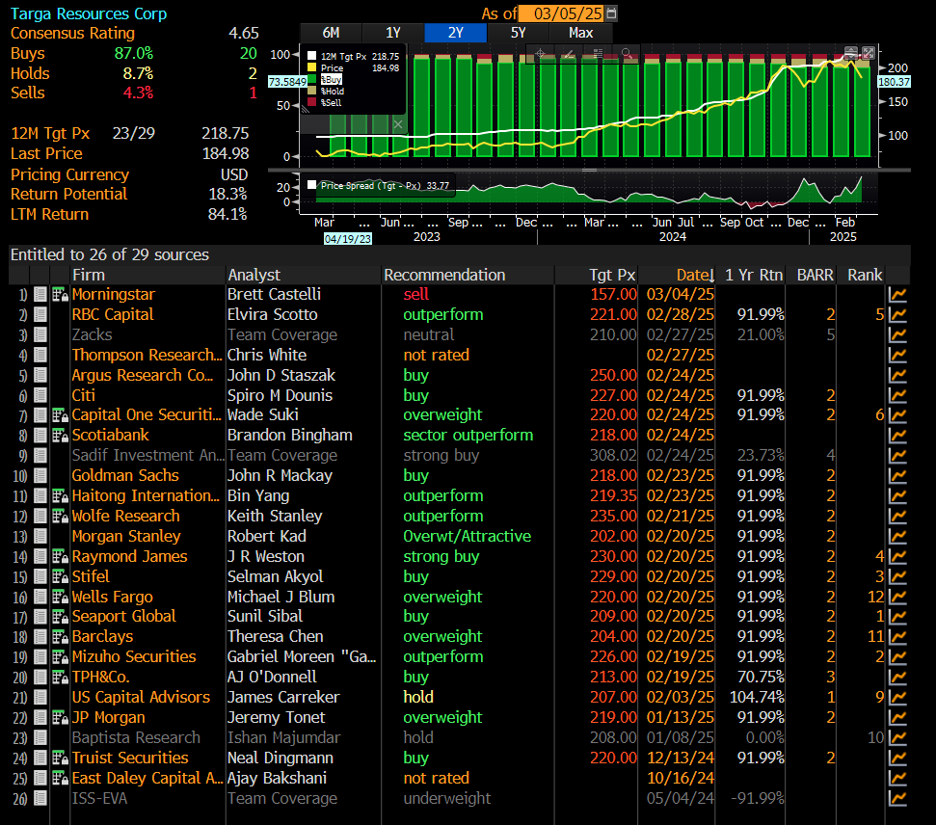
ANR – Analyst Recommendations
12M Tgt Px => 218.8
Return potential 18.3
Out of 29 global recommendation comes out very well
- > Tgt Px goes as high as 250

Slide 15
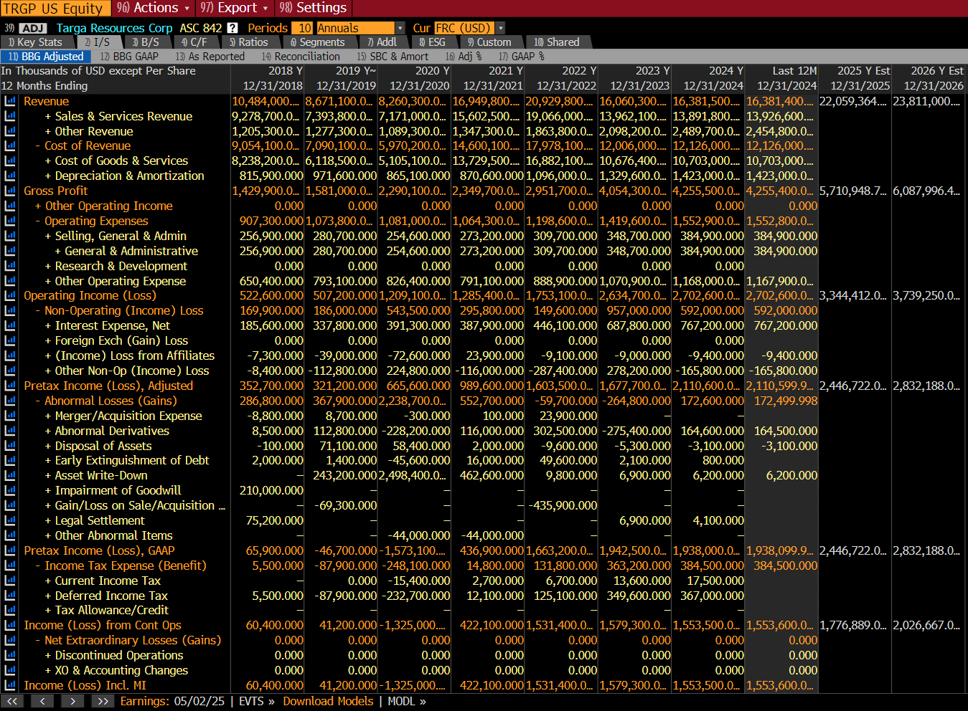
ANR – Analyst Recommendations
Rev: 2025 -> ~22 B
2026 -> ~24 B
Profite: 2025 -> ~5.7 B
2026 -> ~ 6 B
Income: 2025 -> ~3.3 B
2026 -> ~3.7 B

Slide 16
Agenda
Logo here
1
Company Overview
2
Investment Thesis
3
Investment Thesis
4
Valuation
5
Catalysts and Risks
6
Recommendation

Slide 17
Risk and opportunities
Legend
opportunity
risk
Saturation and competition pressure
Climate risk
Political instability
Targa’s fully integrated midstream model
Trump’s administration deregulation and incentives for energetic industries
Targa’s leadership position in Permian basin

Slide 18
Agenda
Logo here
1
Company Overview
2
Investment Thesis
3
Investment Thesis
4
Valuation
5
Catalysts and Risks
6
Recommendation

Slide 19
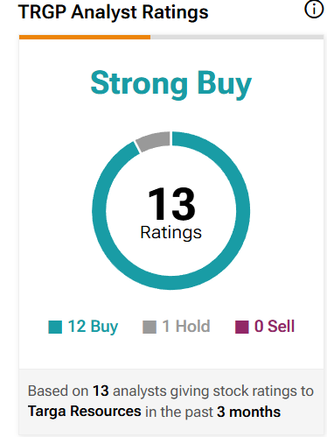
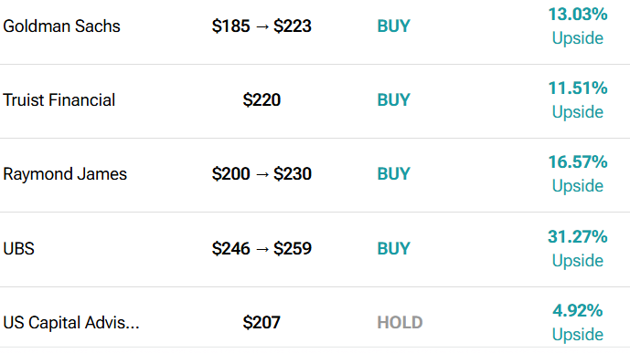
Price Target & Recommendation
Source: Tip Ranks

